Slide 1
Transition Skills
Critical self-reflection

Slide 2
Self-reflection and critical self-reflection
Do you examine your learning experience and come up with ideas to improve your performance and put these ideas into practice?
Do you step back from your learning experience and engage in deeper and more meaningful learning?
Have you ever kept a learning journal?
If you answered ‘no’ to any of the above, you could benefit by developing your skills in self and critical reflection.
Notes:
The first bullet point is one way to define reflection and the second bullet point is one way to define critical self reflection. The learning journal has been identified as a mechanism to develop these.

Slide 3
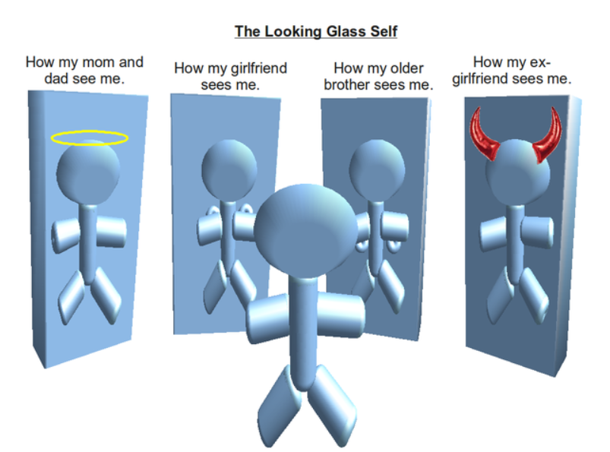
Reflection is something that you may associate with looking in a mirror
Notes:
This image has a creative commons licence and is associated with the work of Charles H Cooley. It is important to get the students to gain some understanding of what reflection is and everyone knows that you can see a reflection of yourself in the mirror. This is an obvious starting point. The image of the looking glass self is a humorous way to introduce the basic idea of reflection being about what is seen in a mirror. How we see ourselves does not come from who we really are, but rather from how we believe others see us. The question then is how do the students see themselves as learners?

Slide 4
Try this activity: encouraging self-reflection
Consider a recent learning experience which you have had. This could be a skill you have developed, such as driving or playing an instrument, or the overall experience of your last year/term/semester/trimester at school, work, college or university.
Use the ‘encouraging self-reflection’ handout or activity provided to answer the following questions.
Identify two things that you did or habits that you developed that helped you to learn.
Now consider how can you apply the things or habits that worked for you before to future learning experiences?
15 minutes
Notes:
These questions encourage students to pause and reflect on a real learning experience.
The questions are roughly based on the taxonomy of reflection model that was developed by Peter Pappas. This in turn is based on Bloom’s taxonomy
A Taxonomy of Lower to Higher Order Reflection
Assume an individual has just completed a task. What types of questions might they use to reflect on the experience? How might those questions parallel Bloom’s Taxonomy?
Bloom’s Remembering: Retrieving, recognising, and recalling relevant knowledge from short- or long-term memory. Reflection: What did I do?
Bloom’s Understanding: Constructing meaning from oral, written, or graphic messages. Reflection: What was important about what I did? Did I meet my goals?
Bloom’s Applying: Carrying out or using a procedure through executing, or implementing. Extending the procedure to a new setting. Reflection: When did I do this before? Where could I use this again?
Bloom’s Analysing: Breaking material into constituent parts, determining how the parts relate to one another and to an overall structure or purpose. Reflection: Do I see any patterns or relationships in what I did?
Bloom’s Evaluating: Making judgments based on criteria and standards. Reflection: How well did I do? What worked? What do I need to improve?
Bloom’s Creating: Combining or reorganizing elements into a new pattern or structure. Reflection: What should I do next? What’s my plan / design?

Slide 5
Try this activity: encouraging self-reflection
Still considering a recent learning experience which you have had. Use the ‘encouraging self-reflection’ handout or activity provided to answer the remaining questions.
Identify two things or habits that could have been better in your previous learning experience.
What were the barriers to you learning before?
How do you hold yourself back from learning?
Based on your responses to the five questions, what could you do differently to make your ability to learn better in the future?
15 minutes
Notes:
These questions encourage students to pause and continue to reflect on a real learning experience.
The questions are roughly based on the taxonomy of reflection model that was developed by Peter Pappas. This in turn is based on Bloom’s taxonomy
The language used here is trying to get students to think about what they could have done better without using the terminology of success and failure. Students often know what they could have done and they have observed the learning behaviour of students who are achieving higher grades than them. Doing better may be defined for academics as gaining deeper knowledge and understanding. For students this often means better marks.
The barriers are what got in the way of the student learning. These may have been outside the students control, for example illness. They could however be related to mindset if a student has established learning behaviour, habits and patterns which are not resulting in high performance. If this were the case then this could become the response to Question 5.
The answer to Question 6 should provide students with the start of a plan

Slide 6
Levels of reflective writing
Descriptive Writing tells the story often from one view point and normally in the sequence that it happened with no reflection on meaning or impact
Descriptive Account with Some Reflection is still focused on telling the story but it starts to include the possibility of questions that could be asked
Reflective Writing includes the telling of the story but external information, questioning of motives and clear reflection is included
Notes:
We are moving through the work shop towards the idea of a learning journal. Before reaching this point, this slide identifies different levels of reflective writing from the simple telling of a story through deeper levels of increasing reflection.
The work is taken from the writings of Jenny Moon which were referenced in the Phase 1 report and for simplicity, only the first 3 of the 4 levels which she identified are included. A deeper level of reflection can be offered to students if it is felt they are already able to differentiate between the four levels.

Slide 7
Try this activity: identifying levels of writing
Read the ‘identifying levels of writing’ handout provided which tells a story in three different ways. Make sure that you can identify which of the stories fall into the three levels of reflective writing. To help you to identify deepening reflection in writing, look for the following shifts (Moon 2004):
from description to reflective account
from no questions to questions to responding to questions
emotional influence is recognised, and then handled increasingly effectively
there is a ‘standing back from the event’
there is a shift from self-questioning, challenge to own ideas
from recognition of relevance of prior experience
in the taking into account of others’ views.
10 minutes
Notes:
The handout tell a story about an incident in the park taken from the work of Jenny Moon. Moon, J (2004) A Handbook of Reflective and Experiential Learning, Routledge Falmer, London. Jenny has provided the following commentary on the quality of reflection in The Park.
The Park (1)This piece tells the story. Sometimes it mentions past experiences, sometimes anticipates the future but all in the context of the account of the story. There might be references to emotional state, but the role of the emotions on action is not explored. Ideas of others are mentioned but not elaborated or used to investigate the meaning of the events. The account is written only from one point of view – that of Annie. Generally ideas are presented in a sequence and are only linked by the story. They are not all relevant or focused In fact – you could hardly deem this to be reflective at all. It is very descriptive. It could be a reasonably written account of an event that could serve as a basis on which reflection might start, though it hardly signals any material for reflection – other than the last few words
The Park (2) In this account there is a description of the same events. There is very little addition of ideas from outside the event – reference to attitudes of others, comments. The account is more than a story though. It is focused on the event as if there is a big question to be asked and answered. In the questioning there is recognition of the worth of exploring the motives for behaviour – but it does not go very far. In other words, asking the questions makes it more than a descriptive account, but the lack of attempt to respond to the questions means that there is little actual analysis of the events. Annie is critical of her actions and in her questions, signals this. The questioning of action does mean that Annie is standing back from the event to a small extent. There is a sense that she recognises that this is a significant incident, with learning to be gained – but the reflection does not go sufficiently deep to enable the learning to begin to occur.
The Park (3) The description is succinct here – just sufficient to raise the issues. Extraneous information is not added. It is not a story. The focus is on the attempt to reflect on the event and to learn from it. There is more of a sense of Annie standing back from the event in order to reflect better on her actions and in order to be more effectively critical. There is more analysis of the situation and an evident understanding that it was not a simple situation – that there might be alternative explanations or actions that could be justified equally effectively. The description could be said to be slightly narrow (see The Park (4)) as Annie is not acknowledging that there might be other ways of perceiving the situation – other points of view. She does not seem to be recognising that her reflection is affected by her frame of reference at the time or now. It is possible, for example, that her experience with Charlie (last paragraph) – or her question about knowing the boy have influenced the manner in which she reacted. It might not just be a matter of linking up other events, but of going beyond and checking out the possibility that her frame of reference might have been affected by the prior experiences.

Slide 8
Supporting the development of critical self-reflection
Both having a learning experience and thinking about it afterwards results in us learning. When this is done with awareness and the intention of identifying areas for deeper learning, the process is known as reflection. Learning experiences include attending a lecture or class meeting, reading, watching a video or engaging in a conversation. Below you will find some practical ways to reflect on learning.
Learning Journals: Learning journals are written or electronic records, which students create as they think about concepts they have learned
Self-reflection
Learning Journals
Peer Review
Portfolios
Peer Review: In peer review, students reflect on their own and others' performance of group tasks
Student Portfolios: A student portfolio is defined as a collection of student work that illustrates the students’ efforts, progress, or achievement
Notes:
This slides attempts to explain the concept of self-reflection with reference to the report on critical self reflection produced in Phase 1.
Learning Journals, Peer Reflection and Student Portfolios were the most commonly identified practical strategies to support the development of critical self reflection in the literature.

Slide 9
Strategies for developing learning journals
Use these strategies to increase your critical self-reflection
A learning journal can be a collection of learning experiences and reflection on them. It can be hand written or electronic.
To start with, choose a learning experience and use the journal entry template to write a reflective journal entry. Return to the journal entry at a later date to reflect for a second time on your learning experience.
The process of initial reflection can be followed by a second reflection.
For example
Word documents or online journals are useful.
Video or audio files can be included.
Learning journals need to be dynamic resources that continue to grow.
Some things you can try
What did you learn?
How did you feel when you were learning?
How can you apply the learning in the future?
What were the barriers to learning?
Try to not treat reflective activities as extra work. Look for its relevance to your learning and you will remain motivated.
There are many online journal tools, mobile phone apps and blogs available. Once you have developed the skills, you can explore these further.
Notes:
The pink boxes indicate strategies which, when used, can enhance a student’s self-reflection. The blue clouds are only suggested responses, as students should be encouraged to think about their own learning experience. The information in the blue cloud can be used to prompt the student in their responses, if needed.
The easiest way to work with a student with these strategies is via template journal entry worksheets (two samples of these are available as a PDF). The first one is structured to prompt the student to answer a series of questions. It takes the students through the process of reflecting on one of their own learning experiences.
Once the student has completed the structured template worksheet, they should be encouraged to return to reflect a second time. The idea is to re visit their initial reflection rather than to revise it. When the student has a better understanding of how to complete a journal entry in a reflective way, they can then use the second journal entry template which is unstructured. This has the same questions but allows free text responses by the student.
The Phase 1 report identifies challenges in promoting critical self reflection including an observation that there is a relative lack of research on the effectiveness of
reflection. Brockbank and McGill (2007) therefore argue that self-reflection on its own is not sufficient to promote critical reflective learning, as a radical shift in both teaching methods and teaching and learning relationships has to take place. Such learning needs to be promoted through a process of reflective dialogue between teachers and learners as well as between students themselves (Fisher 2003). This is because the process of critical self-reflection is closely linked with an individual's active engagement. In other words, if students treat reflective activities as extra work, it may be because they do not see its relevance to their learning or because they are not motivated. Academic staff, therefore, need to encourage and motivate students to get engaged with critical self-reflection. Otherwise, students will tend to comply with the minimum requirements without learning from the process itself (Mann et al 2009; Rogers 2001; Moon 2005).

Slide 10
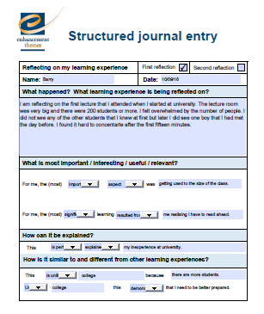
Try this activity: creating learning journal entries
Use the ‘structured learning journal entry’ handout or activity provided and, after choosing a learning experience, go through the questions choosing words from the drop down menus to complete the sentences.
Once you are familiar with the structure you can move to the ‘less structured journal entry’ handout and write your own words.
20 minutes
15min
Notes:
The images of the structured PDFs can be used to explain to student how they can use these tools. The intention of this activity is that students will learn how to write a reflective journal entry and will then need less scaffolding as they develop the skills. Eventually they should be able to use a blank page.
Other Relevant Resources
‘Volunteer Recognition Award’ from UWS.
www.open.ac.uk/choose/unison/develop/my-skills/self-reflection
TED talks
RAE ‘Thinking like an engineer’ http://www.raeng.org.uk/publications/reports/thinking-like-an-engineer-implications-full-report
Mahara open source e-portfolio https://mahara.org
PebblePad http://www.pebblepad.co.uk
Kolb/Gibb learning cycles.

Slide 11
www.enhancementthemes.ac.uk
enhancement@qaa.ac.uk
+44 (0) 141 572 3420
© The Quality Assurance Agency for Higher Education 2023
Registered charity numbers 1062746 and SC037786

